Slide 1

Reusable Components
Based on Chapter 20 of Bennett, McRobb and Farmer:
Object Oriented Systems Analysis and Design Using UML, (2nd Edition), McGraw Hill, 2002.

Slide 2
In This Lecture You Will Learn:
Why reuse is regarded as important
Some of the problems with reuse
How to plan system development to achieve reuse of components
The different techniques for obtaining and managing reuse
How to design a reusable component

Slide 3
Why Reuse?
Reuse allows programmers to save time and effort by reusing other developers’ code
Reuse applies to procedural and functional languages as well (e.g. Fortran and C Libraries)
The growth of Visual Basic can be attributed to the easy availability of reusable controls offering all kinds of functionality
Object-oriented languages have been promoted as enabling reuse

Slide 4
Why Reuse?
Economic argument
Hewlett Packard achieved
  improved productivity
  faster time to market
  fewer defects
  return on investment of 215% on one project, 410% on another
  (Lim, 1994)

Slide 5
Why Reuse?
Quality argument
Reusing a component that has been developed and tested elsewhere saves time and money in testing and wuality assurance
  IBM maintains a library of zero-defect components in Ada, PL/CX and C++
  (Jacobson et al., 1997)

Slide 6
Why Hasn’t O-O Delivered?
Innapropriate choice of projects for reuse
Planning for reuse too late
Level of coupling between classes in an O-O design
Lack of standards for reusable components

Slide 7
Choice of Projects
Jacobson et al. (1997) identify four kinds of software businesses suitable to develop reusable components
  large organizations with a portfolio of projects and IS infrastructure
  hardware developers using embedded software
  consultancy companies, particularly those that work in vertical markets
  large software product developers where components can be reused across a product range

Slide 8
Organizational Structure
Stages of reuse development (maturity)
  no code reuse
  informal code reuse
  black-box code reuse
  managed workproduct reuse
  architected reuse
  domain-specific reuse-driven organization
  (Jacobson et al., 1997)

Slide 9
Organizational Structure
Allen and Frost (1998) argue that organizations do not have the right approach to or mindset for reuse
This requires
  organizational change
  software tools to manage repositories of reusable components

Slide 10
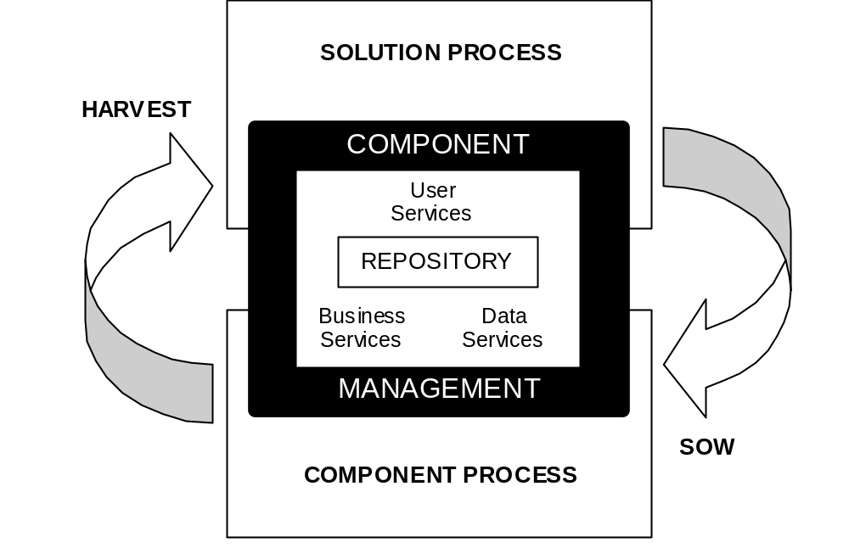
Organizational Structure
Allen and Frost, 1998 (Figure reproduced by permission of Cambridge University Press)

Slide 11
Appropriate Unit of Reuse
Components rather than classes are the unit of reuse
Classes are often too closely linked to other classes
Components are groups of classes that deliver some higher-level functionality

Slide 12
Definitions of Components
Executable unit of code … black-box encapsulation of services
(Allen and Frost, 1998)
Type, class or workproduct … engineered to be reusable
(Jacobson et al., 1997)

Slide 13
Components as Sub-systems
Sub-systems that provide more functionality than a single class
It should also be possible to reuse intermediate products from the life cycle
  use cases
  analysis models
  design models
  test models

Slide 14
Component Standards
Recent factors that promote reuse
  CORBA (Common Object Request Broker Architecture) standard for interoperability of components
  Java as a language with mechanisms to package reusable components (and standards like Enterprise Java Beans)
  the growth of the WWW as a means of distributing reusable components

Slide 15
Component Standards
New standards
  SOAP (Simple Object Access Protocol) based on XML (eXtensible Markup Language)
  Web Services mechanism to find services on the Internet using UDDI
  UDDI (Universal Description, Discovery and Integration) directory service
  .NET and C# (C Sharp not C Hash)

Slide 16
Component Standards
Borland Delphi—object Pascal as DLLs
Visual Basic—.VBX and .OCX
Windows—OLE, DDE, DLLs, COM and DCOM
CORBA—IDL and IOP
Java—JAR files (and WAR and EAR), EJBs
.NET—MSIL, CLR and WSDL

Slide 17
Strategy for Reuse
The SELECT Perspective (Allen & Frost)
Solution process—delivering services to meet business requirements while drawing on the component process in the search for reusable components
Component process—developing reusable components in packages to deliver generic business services

Slide 18
Strategy for Reuse
SELECT Perspective
The analogy of sowing and harvesting
Sowing reusable components and harvesting them in business solutions
A repository for component management is central to this approach, with facilities to store and index components and to browse and search for them

Slide 19
Strategy for Reuse
Reuse-driven Software Engineering Business (RSEB) (Jacobson et al.)
Intermediate artefacts are reusable as well as finished code
Requires an architectural process to design reusable models and code
This requires a change to the way in which the software business operates

Slide 20
Strategy for Reuse
RSEB
Developing a reuse business requires reengineering the organization
  Requirements Capture Unit
  Testing Unit
  Component Engineering Unit
  Architecture Unit
  Component Support Unit

Slide 21
Strategy for Reuse
RSEB
Three engineering processes
  Application Family Engineering (AFE)—produces layered architecture of application and components
  Component System Engineering (CSE)—develops reusable components to support application development
  Application System Engineering (ASE)—develops application systems designed to make use of components produced by CSE

Slide 22
Commercially Available Componentware
VBX, OCX and COM Components
Wide range of components using Microsoft architecture
Controls for
  serial communication
  computer-aided design
  project management
  spreadsheets
  scientific charts
  barcode reading and printing

Slide 23
IBM San Francisco Project
Java distributed server-based components
Layered architecture
  Foundation Layer
  Common Business Objects
  Core Business Processes
    general ledger
    accounts receivable and payable
    warehouse management
    order management

Slide 24
Case Study Example
Each program in the system will be represented by a use case in the use case diagram. One or more actors will be associated with each use case, and each actor may be associated with more than one use case. A member of staff will fill the role of one or more actors, and each actor will be represented by one or more members of staff. Each actor will be given access rights to use specific use cases (programs). A member of staff may only use those use cases (programs) for which one of the actor roles they fill has been given an access right.

Slide 25
Case Study Example
Requirement for a security system
Could be reused in many application systems

Slide 26
Add a use case
Add a staff member
Add an actor
Add an actor role
Add an access right
Remove a staff member
System Manager
Remove a use case
Remove an actor role
Application
Developer
Remove an actor
Check user authorization
Live System
Remove an access right

Slide 27
Actor
UseCase
*
*
name
title
*
AccessRight
ActorRole
*
StaffMember
login
name
password

Slide 28
Actor
UseCase
name : String
title : String
*
*
«responsibilities»
«responsibilities»
add a new actor
remove an actor
add a staff member in actor role
remove a staff member from actor role
add a new use case
remove a use case
add an access right for an actor
remove an access right from an actor
*
*
StaffMember
login : String
name : String
password : String
«responsibilities»
add a new staff member
remove a staff member
change password

Slide 29
Design Decisions
Do we design sub-system with boundary and control classes?
Can we reuse the StaffMember class?
How will application classes be aware of interface to sub-system?
What data storage mechanism will the sub-system use?
What parts of the sub-system will be visible to other applications?

Slide 30
Business Application
Java AWT
Security
Security Server
Security Client
Security Core
Classes
Security Boundary
Classes
Security Server
Control Classes
Security Client
Control Classes

Slide 31
Use of the Façade Pattern
Provide a high-level interface to a sub-system
Used to decouple clients of a sub-system from the internal workings of the sub-system
Simple interface to sub-system
Façade
Gamma et al, 1995 (Figure reproduced by permission of Addison Wesley Longman)

Slide 32
«façade»
SecurityAuthorizer
+ checkAuthorization(login:String, password:String, title:String)
«façade»
SecurityManager
+ addAccessRight(ac:Actor, uc:UseCase)
+ addActor(name:String)
+ addActorRole(ac:Actor, sm:StaffMember)
+ addStaffMember(name:String, login:String, password:String)
+ addUseCase(title:String)
+ listActors( )
+ listActorsByUseCase(uc:UseCase)
+ listStaffMembers( )
+ listStaffMembersByActor(ac:Actor)
+ listUseCases( )
+ listUseCasesByActor(ac:Actor)
+ removeAccessRight(ac:Actor, uc:UseCase)
+ removeActor(ac:Actor)
+ removeActorRole(ac:Actor, sm:StaffMember)
+ removeStaffMember(sm:StaffMember)
+ removeUseCase(uc:UseCase)

Slide 33
AddUseCase
AddActor
AddStaffMember
+ addUseCase(title:String)
+ addActor(name:String)
+ addStaffMember(name:String, login:String, password:String)
RemoveUseCase
RemoveActor
RemoveStaffMember
+ removeUseCase(uc:UseCase)
+ removeActor(ac:Actor)
+ removeStaffMember(sm:StaffMember)
ListUseCases
ListActors
ListStaffMembers
+ listUseCases( )
+ listUseCasesByActor(ac:Actor)
+ listActors( )
+ listActorsByUseCase(uc:UseCase)
+ listActorsbyStaffMember(sm:StaffMember)
+ listStaffMembers( )
+ listStaffMembersByActor(ac:Actor)
AddAccessRight
AddActorRole
RemoveAccessRight
+ addAccessRight(ac:Actor, uc:UseCase)
+ addActorRole(ac:Actor, sm:StaffMember)
+ removeAccessRight(ac:Actor, uc:UseCase)
CheckAuthorization
RemoveActorRole
+ checkAuthorization(login:String, password:String, title:String)
+ removeActorRole(ac:Actor, sm:StaffMember)

Slide 34
UseCase
UseCaseCollection
- actors: OSHashTable
- title : String
- useCases: OSHashtable
1
*
+ addUseCase( )
+ removeUseCase( )
+ listUseCases( )
+ findUseCaseByTitle( )
+ addActor( )
+ removeActor( )
+ getTitle( )
+ listActors( )
1
*
*
1
Actor
ActorCollection
- name : String
- staffMembers: OSHashTable
- useCases: OSHashtable
- actors: OSHashTable
1
*
+ addActor( )
+ removeActor( )
+ listActors( )
+ findActorByName( )
+ addStaffMember( )
+ removeStaffMember( )
+ addUseCase( )
+ removeUseCase( )
+ getName( )
+ listStaffMembers( )
+ listUseCases( )
*
1
1
*
StaffMember
- actors: OSHashTable
- login : String
- name: String
- password: String
StaffMemberCollection
- staffMembers: OSHashTable
1
*
+ addStaffMember( )
+ removeStaffMember( )
+ listStaffMembers( )
+ findStaffMemberByLogin( )
+ addActor
+ removeActor
+ getName
+ setPassword
+ listActors
+ addActor( )
+ removeActor( )
+ getName( )
+ getPassword( )
+ setPassword( )
+ listActors( )

Slide 35
Java RMI
Business Application
Java AWT
Security
Security Server
Security Facade
Security Client
Security Core
Classes
«façade»
CheckAuthorization
Security Boundary
Classes
Security Server
Control Classes
«façade»
SecurityManager
Security Client
Control Classes
ObjectStore PSE Pro
com.ODI
com.ODI.util
com.ODI.imp

Slide 36
SecurityFaçade.jar
CheckAuthorization
Agate.jar

Slide 37
Summary
In this lecture you have learned about:
Why reuse is regarded as important
Some of the problems with reuse
How to plan system development to achieve reuse of components
The different techniques for obtaining and managing reuse
How to design a reusable component

Slide 38
References
Allen and Frost (1998)
Jacobson et al. (1997)
Orfali and Harkey (1998)
(For full bibliographic details, see Bennett, McRobb and Farmer)

